Slide 1
Used Car Price Prediction Project Presentation
Submitted
by
Benjamin emmanuel

Slide 2
ACKNOWLEDGMENT
I'd like to express my heartfelt gratitude to my SME (Subject Matter Expert) Mohd. Kashif, as well as Flip Robo Technologies, for allowing me to work on this project on Used Car Price Prediction and for assisting me in conducting extensive research, which allowed me to learn a lot of new things, particularly in terms of data collection.In addition, I used a few outside resources to help me finish the project. I made sure to learn from the samples and adjust things to fit my project's needs.

Slide 3
ACKNOWLEDGMENT
All the external resources that were used in creating this project are listed below:
1) https://www.google.com/
2) https://www.youtube.com/
3) https://scikit-learn.org/stable/user_guide.html
4) https://github.com/
5) https://www.kaggle.com/
6) https://medium.com/
7) https://towardsdatascience.com/
8) https://www.analyticsvidhya.com/

Slide 4
PROBLEM STATEMENT
With the covid 19 impact in the market, we have seen lot of changes in the car market. Now some cars are in demand hence making them costly and some are not in demand hence cheaper. One of our clients works with small traders, who sell used cars. With the change in market due to covid 19 impact, our client is facing problems with their previous car price valuation machine learning models. So, they are looking for new machine learning models from new data. We have to make car price valuation model.

Slide 5
DATA COLLECTION PHASE
You have to scrape at least 5000 used cars data. You can scrape more data as well, it’s up to you. more the data better the model
In this section You need to scrape the data of used cars from websites (OLX, Car Dekho, Cars 24 etc.) You need web scraping for this. You have to fetch data for different locations. The number of
columns for data doesn’t have limit, it’s up to you and your creativity. Generally, these columns are Brand, model, variant, manufacturing year, driven kilometers, fuel, number of owners, location and at last target variable Price of the car. This data is to give you a hint about important variables in used car model. You can make changes to it, you can add or you can remove some columns, it completely depends on the website from which you are fetching the data.
Try to include all types of cars in your data for example- SUV, Sedans, Coupe, minivan, Hatchback.

Slide 6
MODEL BUILDING PHASE
After collecting the data, you need to build a machine learning model. Before model building do all data pre-processing steps. Try different models with different hyper parameters and select the best model. Follow the complete life cycle of data science. Include all the steps below.
1. Data Cleaning
2. Exploratory Data Analysis
3. Data Pre-processing
4. Model Building
5. Model Evaluation
6. Selecting the best model

Slide 7
DATA SCIENCE LIFE CYCLE
Data Cleaning
Import the data scraped from the web. Using various imputation techniques, clean and format the records according to their intended use.
Exploratory Data Analysis
Examine all of the dataset's details, such as datatype, missing values, and duplicate values. Analyze each and every data record to ensure we have information that can be used.
Visualization and Data Preprocessing
Check the data distribution using various visualisation approaches. find see if there are any outliers or skewness Apply encoding and scaling techniques.

Slide 8
DATA SCIENCE LIFE CYCLE
Model Building
Create appropriate Regression Machine Learning model function
Model Evaluation
Usage of evaluation metrics to check the accuracy of the models over trained and test data inputs
Hyperparameter Tuning Best Model
Choosing the appropriate Regression Machine Learning model to check various parameter permutation and combinations
Need to ensure that whenever the regression function is called it is able to process all the necessary parameters
Ensure the cross validation techniques helps in reducing over fitting and under fitting data
Using Grid Search CV to obtain the best parameters that can be plugged into the selected model

Slide 9
WEB SCRAPING FOR USED CAR DETAILS

Slide 10
DATA PREPROCESSING
Importing the required libraries and dependencies.The CSV file was read and turned into a data frame.Checking the original dataset's data dimensions.Look for null values and fill up the blanks accordingly.Examining the dataset's summary.Checking for distinct values.Checking all of the dataset's category columns.

Slide 11
DATA PREPROCESSING
Using matplotlib and seaborn to visualise each feature.
On categorical characteristics, the ordinal encoder is used to do encoding.
In a heatmap, look for co-relation/multi-collinearity.Using a boxen plot and a distribution plot, look for outliers or skewness.
Scale using the Standard Scaler technique.Confirming the input details by looking at the dataset's final dimension.
Making a train test split and determining the optimum random state in the range of 1-1000.

Slide 12
TECHNOLOGY USED
Hardware technology being used.
RAM : 16 GB
CPU : Intel(R) Core(TM) i7-9750H CPU @ 2.60GHz 2.59 GHz
Software technology being used.
Programming language : Python
Distribution : Anaconda Navigator
Browser based language shell : Jupyter Notebook
Libraries/Packages specifically being used.
Pandas, NumPy, matplotlib, seaborn, scikit-learn, pandas-profiling, missingno

Slide 13
EXPLORATORY DATA ANALYSIS (EDA) AND VISUALIZATION
01. Univariate Analysis
03. Correlation of Dataset
05. Conclusion
The most basic type of data analysis is univariate analysis. Because "uni" implies "one," your data only has one variable..
Correlation is a statistical method for examining correlations between quantitative and categorical data.
The conclusion of all of the analysis is summarised in this section.
02. Multivariate Analysis
04. Correlation with Target variable
Multivariate analysis is a collection of statistical approaches for analysing data with several variables.
To figure out how the data is related, use correlation with the target variable.

Slide 14
EXPLORATORY DATA ANALYSIS (EDA)
First, I loaded the complete dataset into our Jupyter Notebook after importing the appropriate libraries and renaming the project file from untitled.
Then I looked at the layout of our data and saw that we have 10,000 rows and six different columns.
We don't have any null or missing values in our web scraping dataset.Although our dataset contains a few duplicate rows/records, I choose to keep them rather than delete them.
By looking at the data types, I discovered that our data set contains columns with only object datatypes, even if numeric data was there.
Shape : 10,000 rows and 6 columns
No null values present
Few duplicate rows/records were found
Datatype of only object columns are in dataset

Slide 15
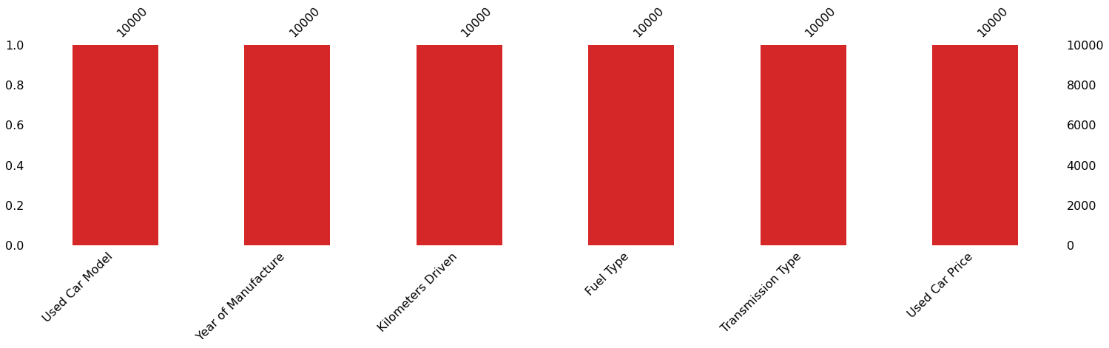
MISSING VALUES VISUAL USING MISSINGNO

Slide 16
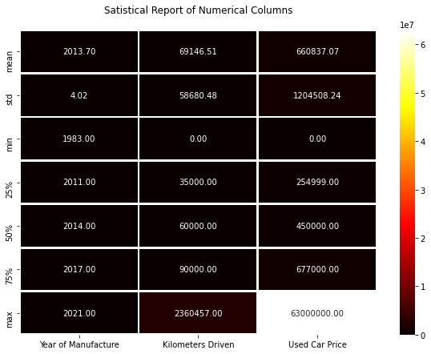
DESCRIBE DATASET VISUAL ON NUMERIC DATA

Slide 17
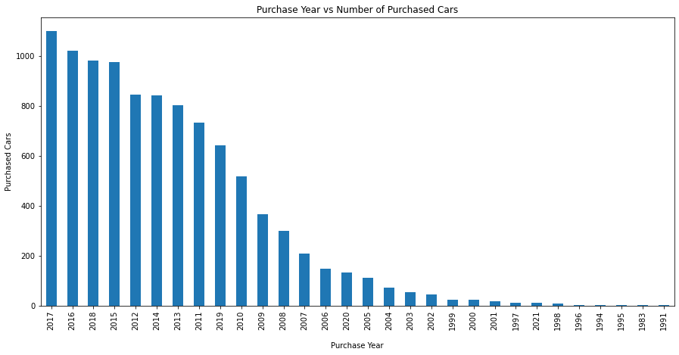
PURCHASE DETAILS OF USED CARS EACH YEAR

Slide 18
COUNT PLOTS

Slide 19
BAR PLOTS

Slide 20
PAIR PLOTS

Slide 21
OUTLIERS WITH BOXEN PLOTS

Slide 22
SKEWNESS WITH DISTRIBUTION PLOTS

Slide 23
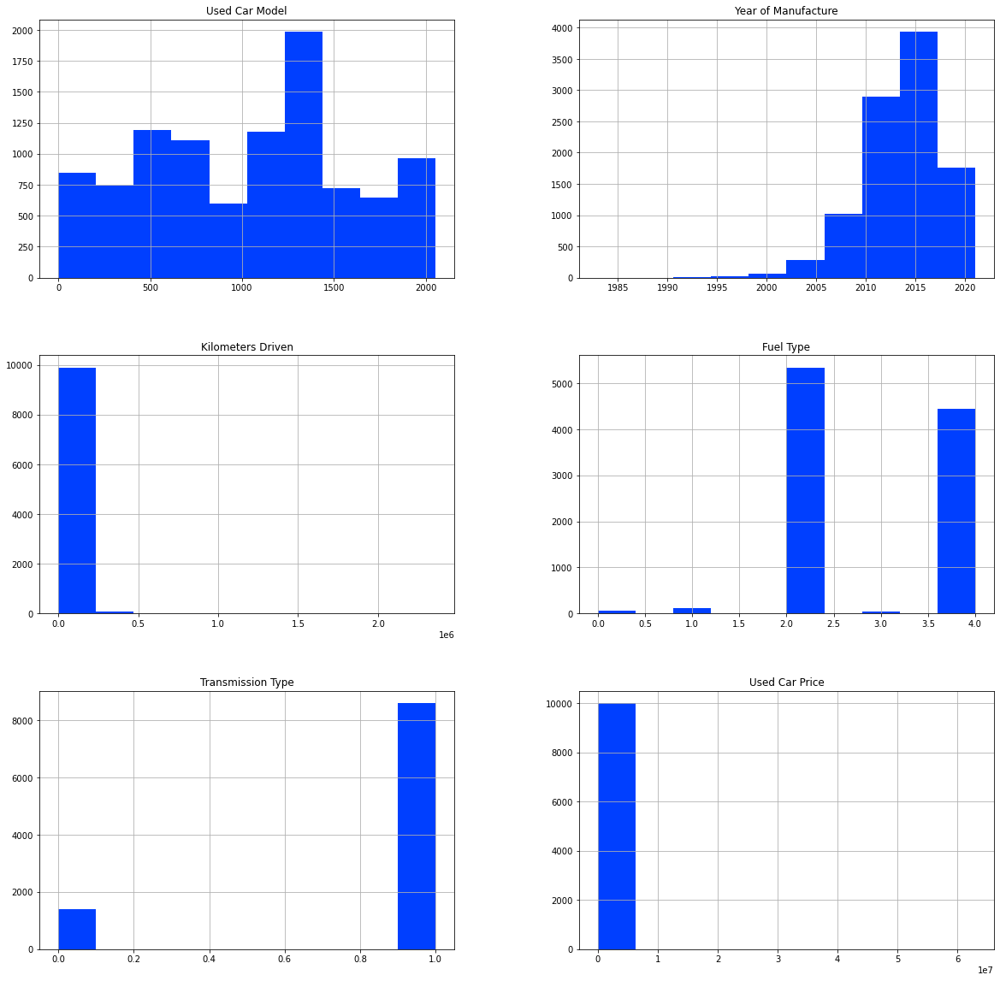
HISTOGRAM

Slide 24
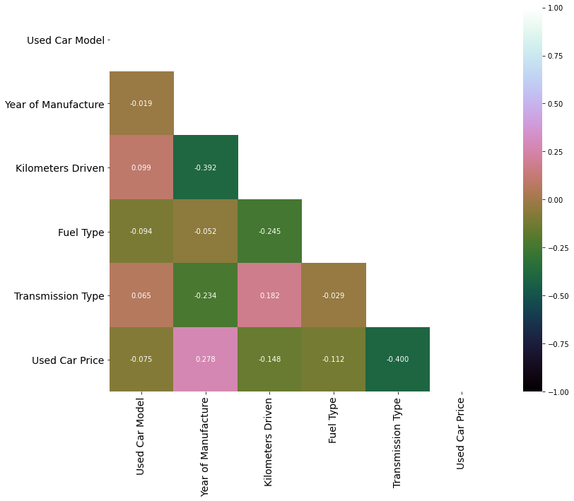
HEATMAP

Slide 25
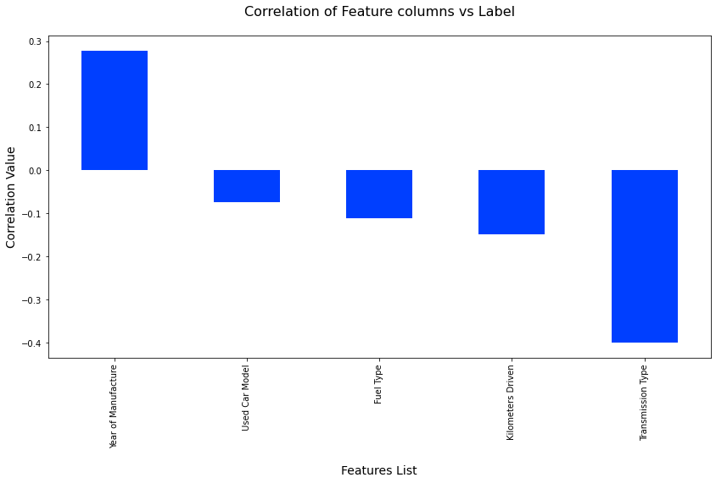
CORRELATIONS BAR GRAPH

Slide 26
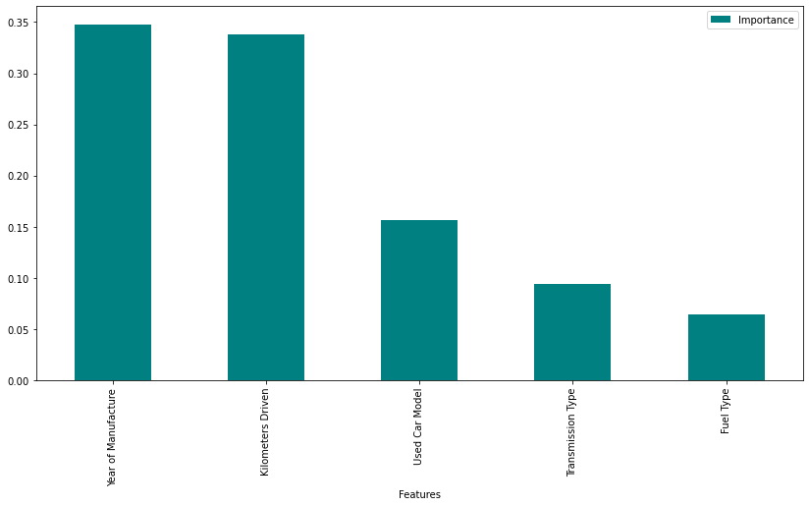
FEATURE IMPORTANCE BAR GRAPH

Slide 27
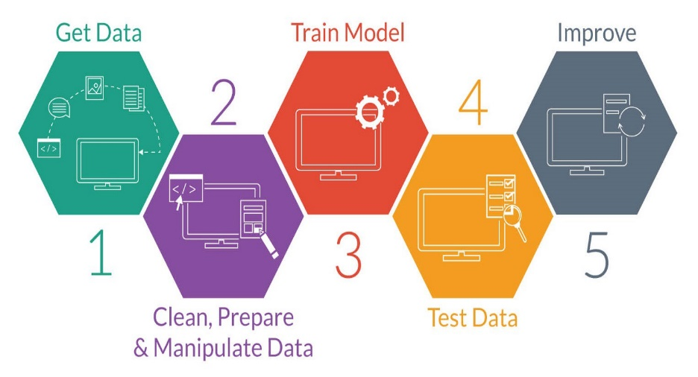
MODEL TRAINING PHASES

Slide 28
REGRESSION MACHINE LEARNING MODEL/S USED
▪ Linear Regression Model
▪ Ridge Regularization Model
▪ Lasso Regularization Model
▪ Support Vector Regression Model
▪ Decision Tree Regression Model
▪ Random Forest Regression Model
▪ K Neighbours Regression Model
▪ Gradient Boosting Regression Model
▪ Ada Boost Regression Model
▪ Extra Trees Regression Model

Slide 29
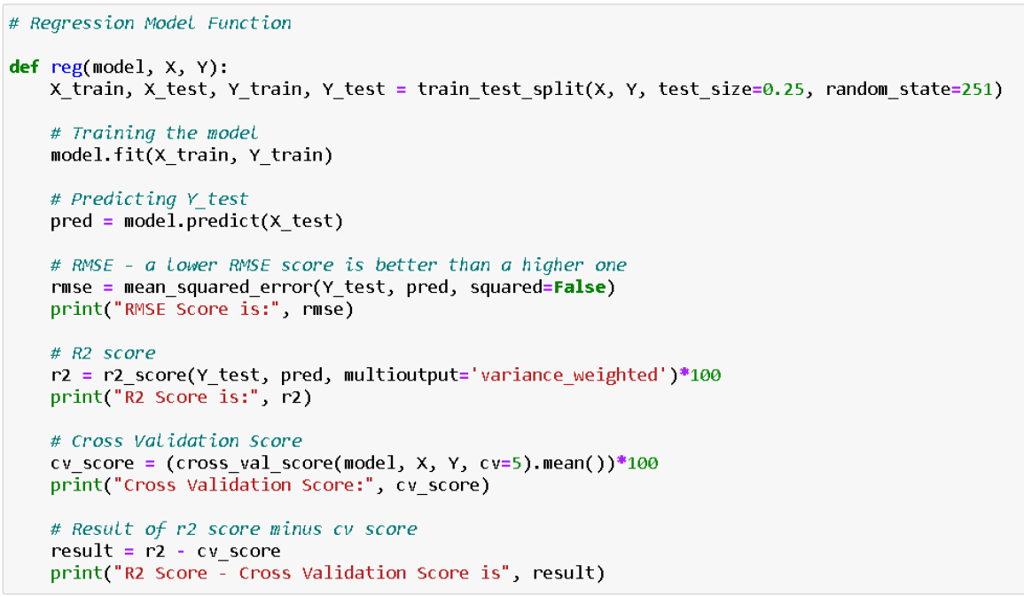
REGRESSION MODEL FUNCTION WITH EVALUATION METRICS

Slide 30
RESULT OF MULTIPLE REGRESSION MODELS

Slide 31
EVALUATION AND HYPER PARAMETER TUNING
The key metrics used here were:
R2 score
Cross Validation Score
MAE
MSE
RMSE
We tried to find out the best parameters list to increase our accuracy scores by using Hyperparameter Tuning. In order to achieve a higher score we used the Grid Search CV method with 5 folds.

Slide 32
CONCLUSION
We gained knowledge into how to collect data, pre-process the data, analyse the data, and construct a model after completing this project. First, we used Web Scraping to acquire data on used automobiles from several websites such as OLX, Car Dekho, Cars 24, and OLA.
Beautiful Soup and Selenium were utilised for web scraping, which provides the advantage of automating our data collection process. We gathered about 10,000 pieces of information, including the selling price of used autos and other relevant details. The scraped data was then integrated into a single data frame and saved as a csv file, which we could then open and examine.

Slide 33
CONCLUSION
We cleaned the data and performed data pre-processing tasks such as discovering and handling null values, removing words from numbers, converting objects to int types, data visualisation, and handling outliers and skewness, among other things. We started testing multiple machine learning regression techniques to discover the best performing model after separating our train and test data.
According to their r2 score and cross validation scores, the Extra Tree Regressor Algorithm performed well. Then, using Grid Search CV, we used the Hyperparameter Tuning approach to find the optimal parameters and improve the score. Although the Extra Tree Regressor Algorithm did not do as well as the defaults, we decided to use it for future forecasts because it was still better than the rest. After receiving a dataframe containing anticipated and real used car price details, we stored the final model in pkl format using the joblib package.

Slide 34
LIMITATIONS OF THIS WORK AND SCOPE FOR FUTURE WORK
The limitations we faced during this project were:
The website was badly constructed because scraping took a long time and getting the next page was difficult. In addition, more practise with various web scraping techniques is required. There were more negative connected data than positive correlated data. Outliers and skewness were found, and we had to lose some valuable data while dealing with them. Because no instructions for dealing with these fast-paced websites were supplied, the web scraping process took longer.
Future Work Scope:
The current model is confined to used car data, but by training the model appropriately, it can be enhanced for various types of automobiles. By training the model with more precise data, the overall score can be increased even more.

Slide 35
